Slide 1
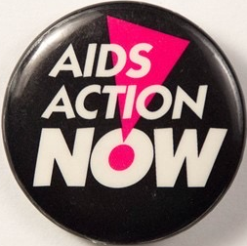
The AIDS Crisis in Canada
AIDS Action Now. Button. Catalogue number
CB47. The ArQuives: Canada’s LGBTQ2+ Archives. Toronto, ON. https://collections.arquives.ca/en/permalink/artifacts4911.

Slide 2
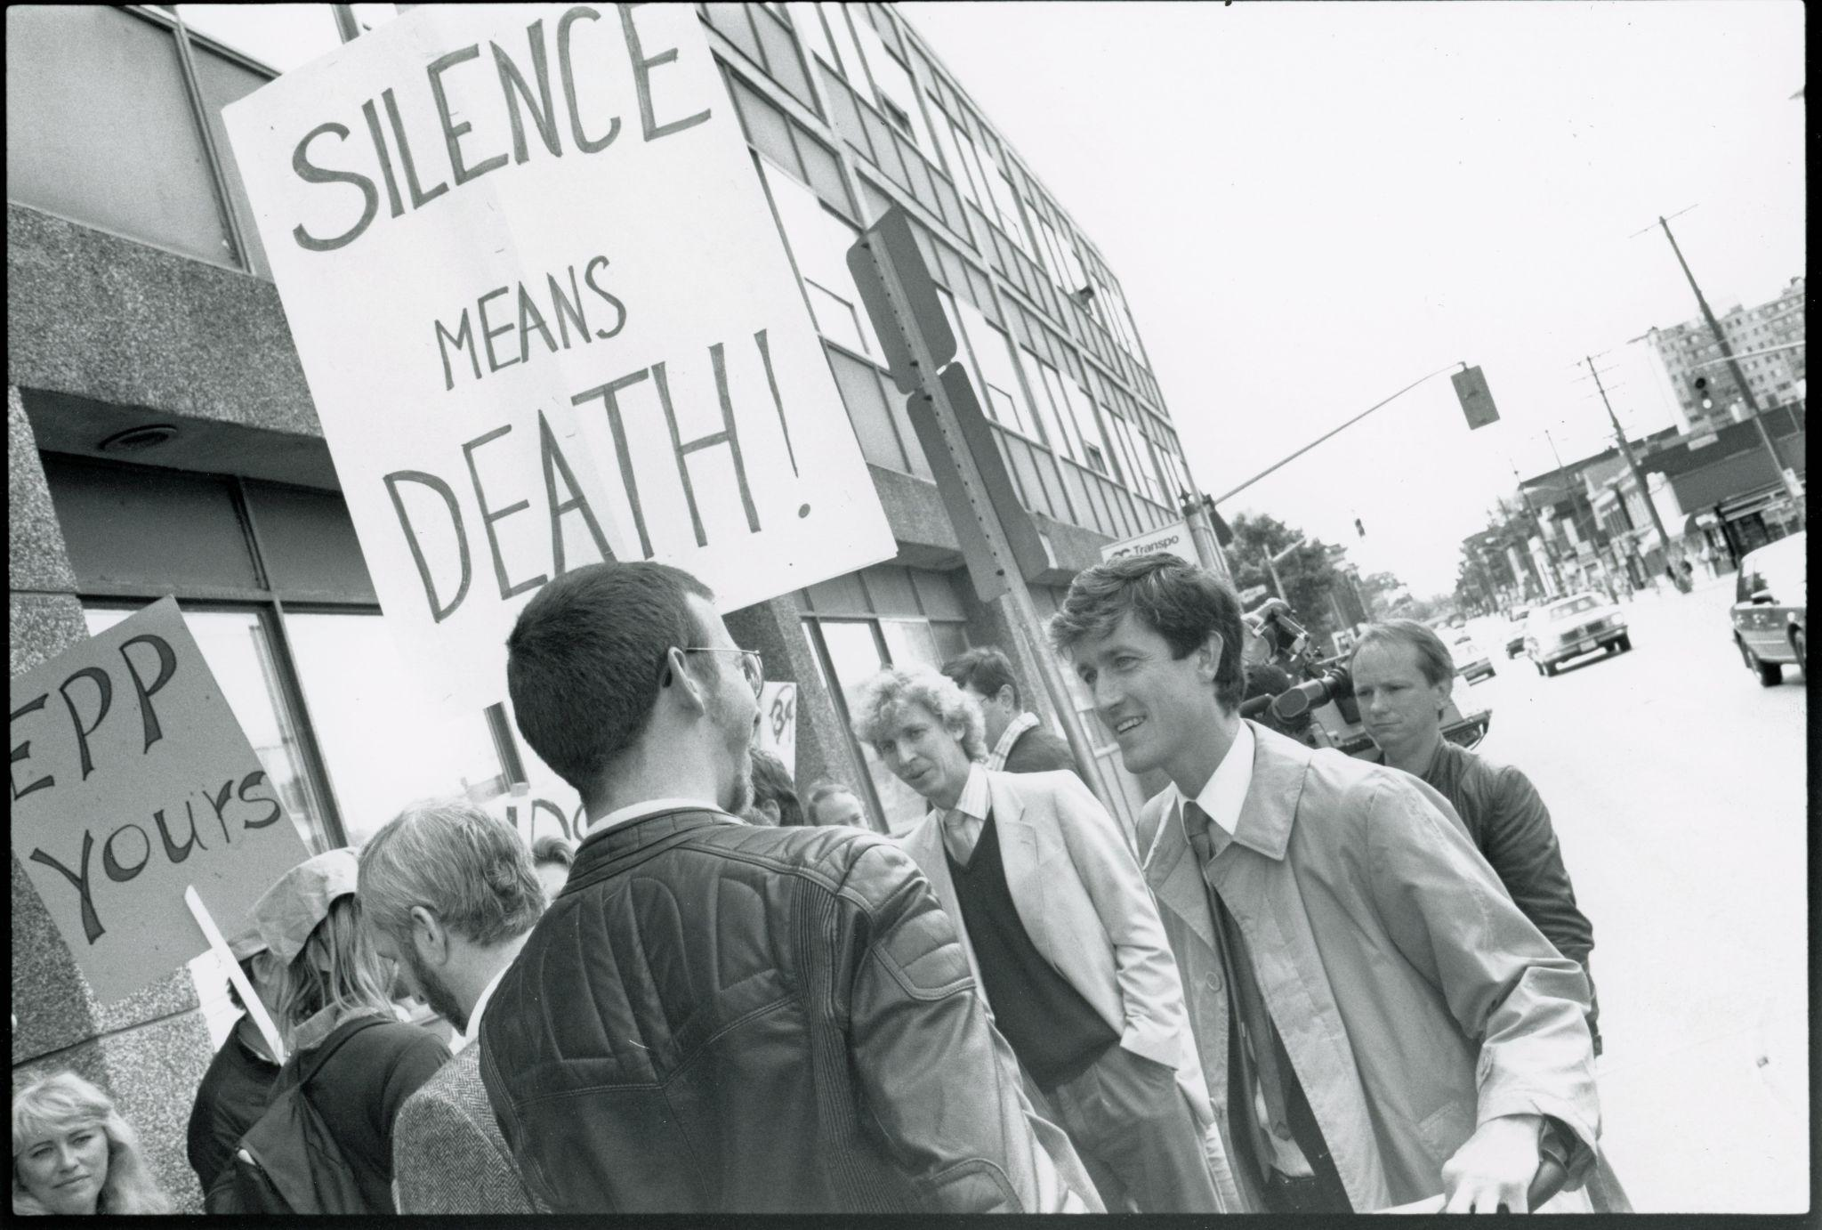
Photo of an AIDS Action Now! march, 1980s. One person’s sign is a reference to politician Jake Epp, whose refusal to implement a National AIDS Strategy significantly worsened the AIDS crisis.
Hannan, P. (198-?). Photograph of
AIDS Action Now! Protest. Item number 2006-153/03P. The ArQuives: Canada’s LGBTQ2+ Archives. Toronto, ON. https://collections.arquives.ca/en/permalink/descriptions22035.

Slide 3
What is HIV/AIDS?
HIV (Human Immunodeficiency Virus) causes a person’s immune system to become weakened. If an HIV-positive person does not have access to treatment, they can develop AIDS (Acquired Immunodeficiency Syndrome).
Because of their weakened immune systems, people with AIDS are susceptible to opportunistic infections, including viral-induced cancers.

Slide 4
What was the AIDS crisis?
In 1981, the US Centers for Disease Control (CDC) received reports of a rare disease in young gay men living in New York and San Francisco.
They initially called this disease ‘GRID’ (Gay-Related Immune Deficiency), but they later it renamed ‘AIDS’ (Acquired Immune Deficiency Syndrome).
The first case of AIDS in Canada was reported in 1982, although suspected cases were retroactively reported from at least 1979.

Slide 5
What else was happening in queer communities in Canada around this time?
There were no legal protections on the basis of sexual orientation or gender identity/
expression.
Police raids of bathhouses were common (e.g., “Operation Soap” in Toronto).
While Pride protests were being held in cities across Canada, queer people continued to be marginalized.

Slide 6
Watch a selection from Anthony Mohamed’s interview with Jennifer Aja Fernandes on the formation of the Alliance for South Asian AIDS Prevention and other community-based AIDS activist groups in the late 1980s and early 1990s (watch from 59:18-1:03:07).
Mohamed, A. & Fernandes, J. A. (2019). Interview with Anthony Mohamed. File
number F0184-01-003. The ArQuives: Canada’s LGBTQ2+ Archives. Toronto, ON. https://collections.arquives.ca/en/permalink/descriptions42708.

Slide 7
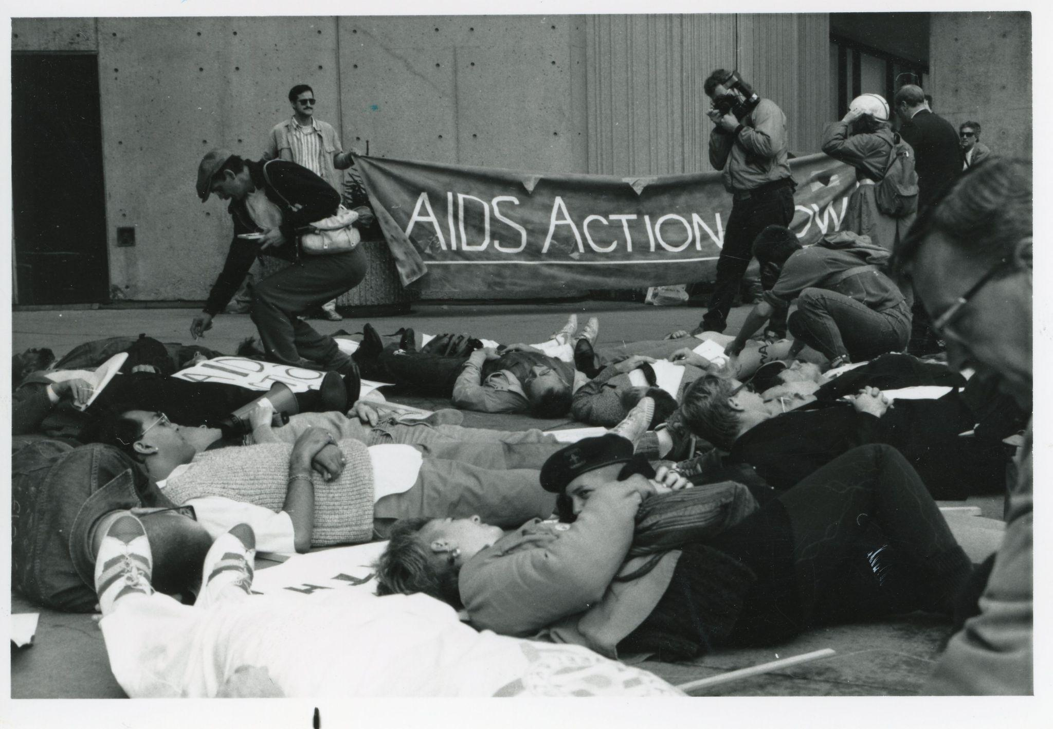
The association of AIDS with men who had sex with men (and, later, with intravenous drug users) meant that many politicians were indifferent.
Activist organizations like AIDS Action Now! (AAN!) protested government inaction and developed networks of community care.
Although pharmaceutical companies were conducting drug trials throughout this period, most early treatments for HIV/AIDS were ineffective and/or inaccessible.
Ladell, D. (198-?). AIDS Action Now! demonstration [photograph].
Item number 2006-153/64P. The ArQuives: Canada’s
LGBTQ2+ Archives. Toronto, ON. https://collections.arquives.ca/en/permalink/descriptions22035.
Photo of a die-in protest organized by AAN!, 1980s.

Slide 8
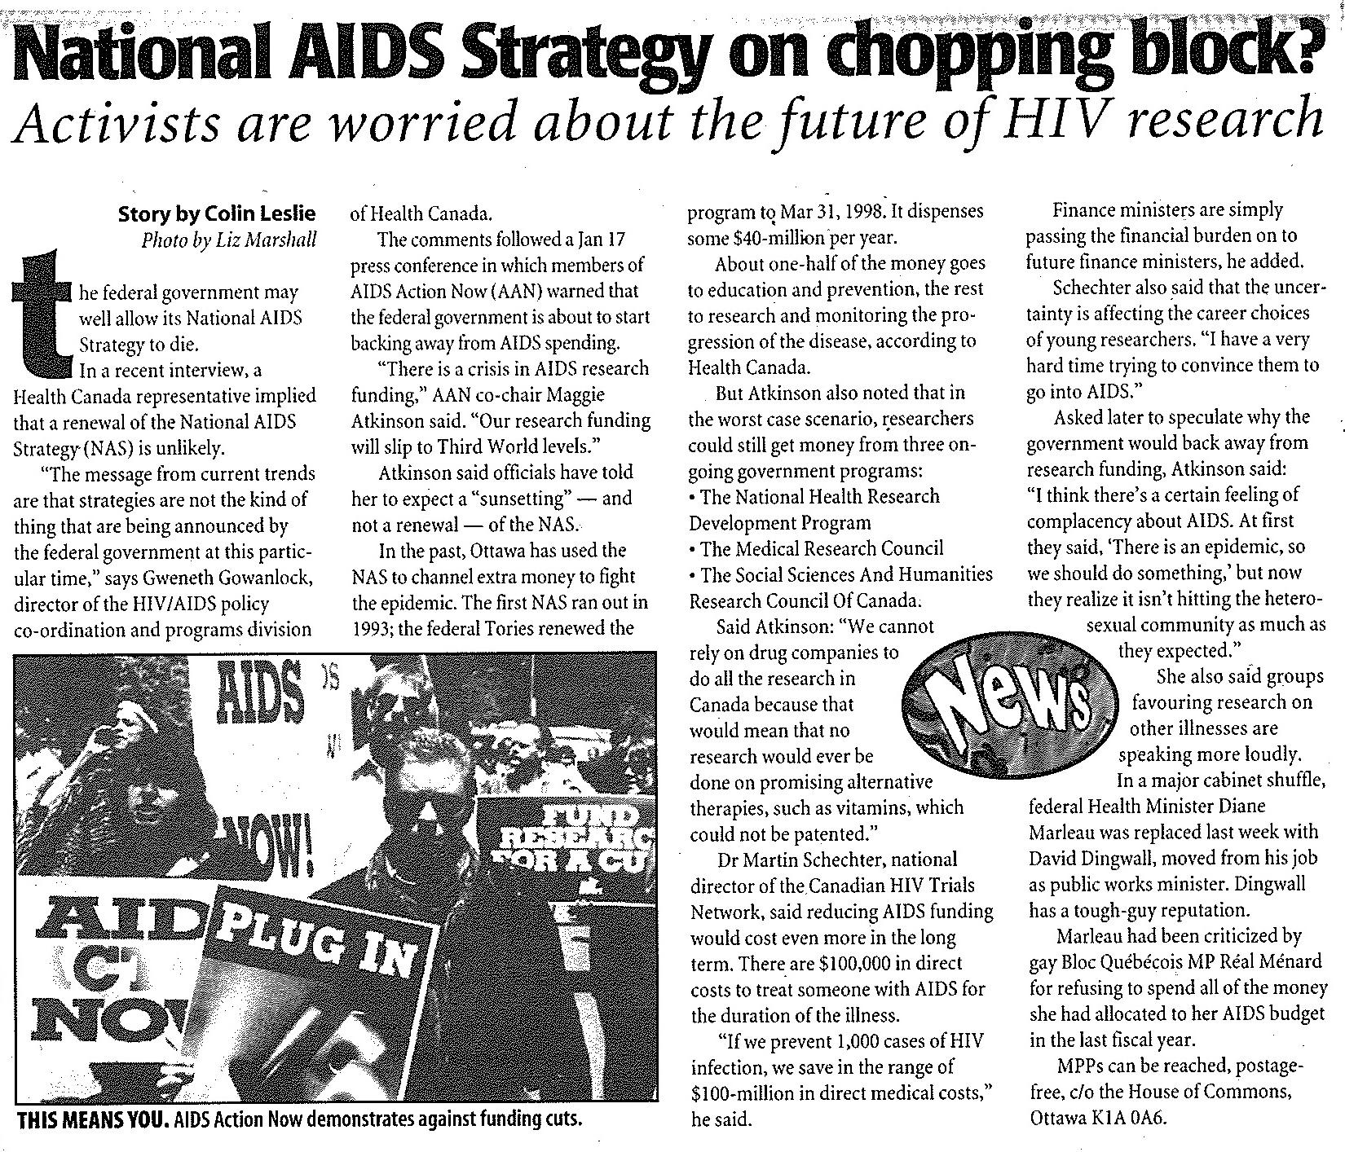
Work on the development of a National AIDS Strategy (NAS) started in 1989; the first NAS expired in 1993, but was renewed until 1998.
In 1996, the federal government indicated that it planned to shut down the program.
In response, AAN! organized an ad campaign in the Globe & Mail and urged people to write letters to their MPs.
In 1998, the NAS was replaced with the Canadian Strategy on HIV/AIDS (CSHA). The CSHA was intended to be a collaborative project that would include communities affected by HIV/AIDS in the research process.
Article published in the February 1, 1996 issue of Xtra! on the cancellation of the NAS.
Leslie, C. (1996, Feb. 1). National AIDS Strategy on chopping block?.
Xtra!. Canada National AIDS Strategy vertical file. The ArQuives: Canada’s LGBTQ2+ Archives. Toronto, ON. https://collections.arquives.ca/en/permalink/verticalfile6594.

Slide 9
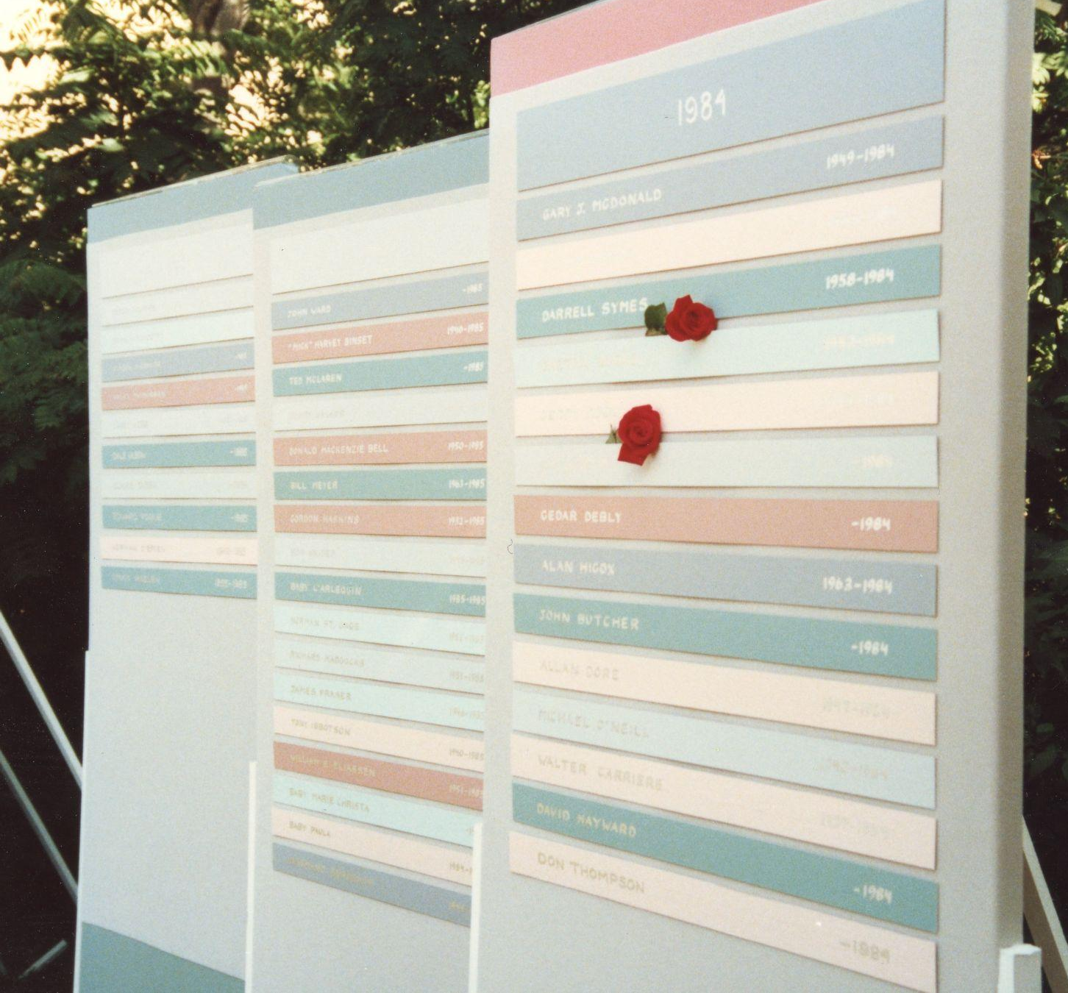
By 1989, nearly 5000 people in Canada had been diagnosed with AIDS; over 2500 people were reported to have died of AIDS-related causes.
Photo of an AIDS Memorial in Toronto, ca. 1988. Starting in the mid-1980s, Michael Lynch and other AIDS activists had been making temporary memorials for the city’s annual Pride events. In the mid-1990s, a permanent AIDS Memorial was installed at Barbara Hall Park (then Cawthra Park).
Ladell, D. (1988?). Lesbian and Gay Pride Day
Photographs. Fonds number F0003-02-072. The ArQuives: Canada’s LGBTQ2+ Archives. Toronto, ON. https://collections.arquives.ca/en/permalink/descriptions47000.

Slide 10
References and Further Reading
Public Health Agency of Canada. (2014). HIV and AIDS in Canada: A surveillance report to December 31,
2013. Minister of Public Works and Government Services Canada.
http://www.phac-aspc.gc.ca/aids-sida/publication/survreport/2013/dec/assets/pdf/hiv-aids-surveillence-eng.pdf.
Public Health Agency of Canada. (2006). Strengthening federal action in the Canadian response to
HIV/AIDS. Federal Initiative to Address HIV/AIDS in Canada.
https://www.canada.ca/en/public-health/services/hiv-aids/federal-initiative-address-hiv-aids-canada/strengthening-federal-action-canadian-response-hiv-aids/canadian-response-hiv-aids.html.

